Slide 1
PROJECT PRESENTATION ON CAMARADEREI (PROBLEM SOLVER WEBSITE)
SANJEEV KUMAR 1811981361
SEJAL GORANA 1811981283
SHASHWAT TYAGI 1811981289
KETAN BHAN 1811981388
ASHWINI KUMAR BHARTI 1811981369

Slide 2
Introduction
The title of our website is CAMARADERIE which means mutual trust and friendship among people As same as our motto behind building this website is to bring world closer, solve their problems and create a community online like family to create a new camaraderie.

Slide 3
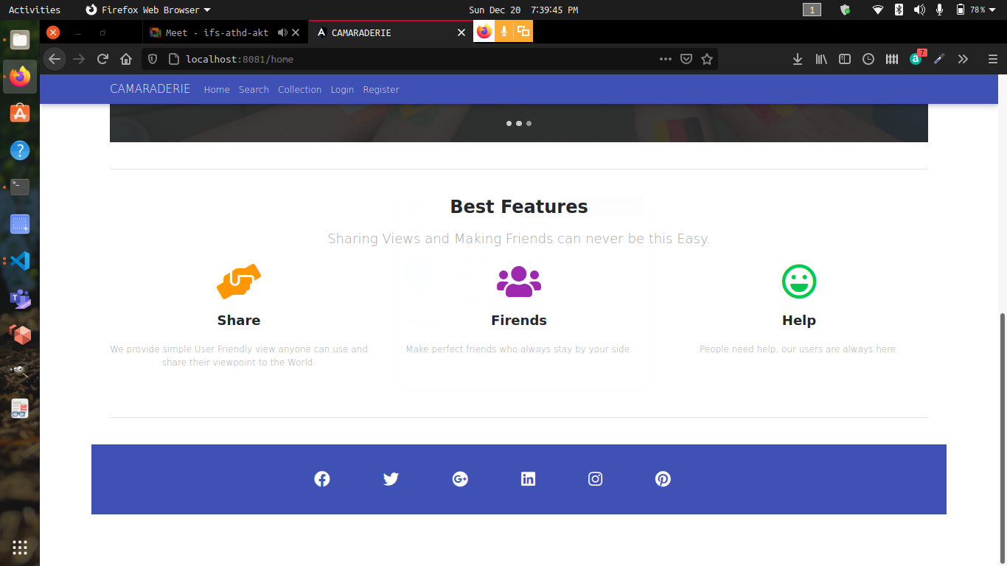
Basic home page layout of our website

Slide 4
Problem statement
In this world population of trillions, people are still alone everyone has something that they want to share and talk about that they can not share with there knowns because of the fear judgement and insecurity this platform provides a space for people to share their deepest thoughts and questions without sharing your real identity, without any fear of judgment and find people who can help you to find answers.

Slide 5
Tools method
FRONTEND :- HTML, CSS, JAVASCRIPT,
BOOTSTRAP4, JQUERY,
ANGULAR.
BACKEND :- NODE JS, MongoDB.
PLATFORM :- Visual Studio Code

Slide 6
Conclusion
This is full fledged problem solving website. Questions that affect the world, questions that guide important life decisions, and questions that provide insights into why other people think differently. This is a place where you can ask questions you care about and get answers that are helpful.

Slide 7
Thank you

